Slide 1
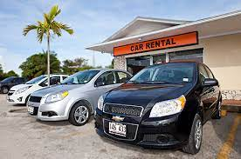
EZ Car Rental Company Case Study
Objective: Visualize the on-demand patterns of car at EZ nationwide
Presenter: Rupali Hangekar

Slide 2
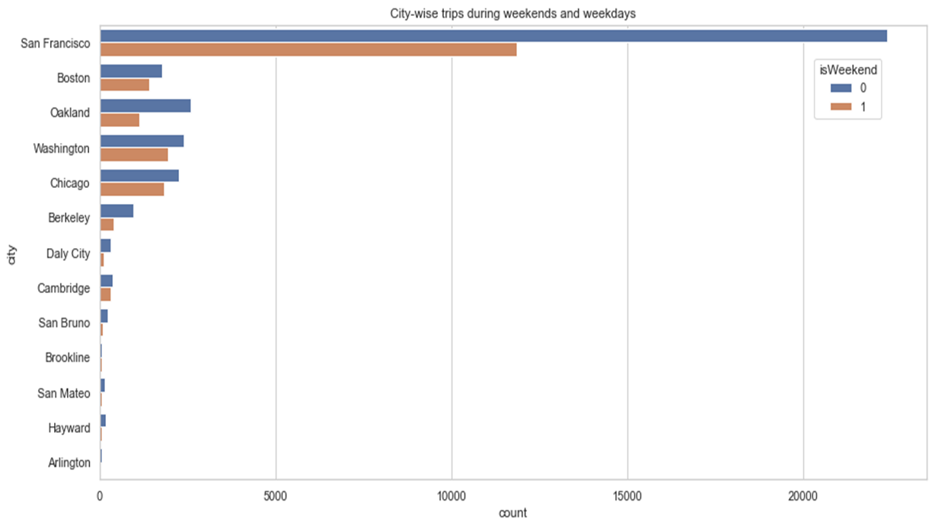
Considering both the weekend & weekday journey start time, San Francisco people are using EZ car rental service more often followed by Oakland, Washington, Chicago and Boston.
Note that the difference between the first and the second top cities is too high.
EZ car rental company has lowest customers in Daly City, Cambridge, San Bruno, Brookline, San Mateo, Hayward and Arlington.
Lastly, it seems that the usage of rental cars is more during weekends (Saturday & Sunday).

Slide 3
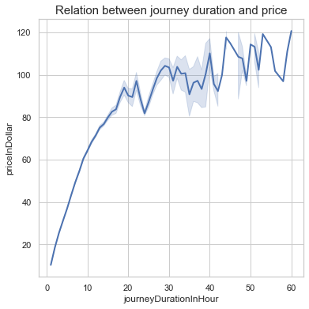
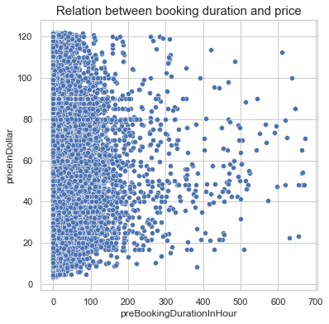
The above graph depicts that the price of car and the trip duration is linearly correlated.
The car rent might be decreasing due to factors such as time of the day, month, etc.
A majority of people book car not more than a week prior to their journey

Slide 4
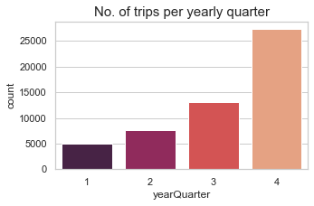
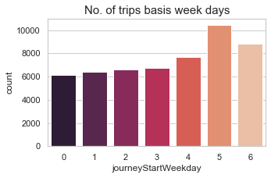
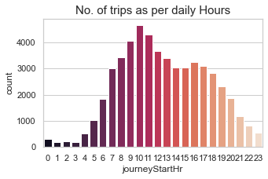
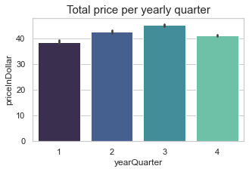
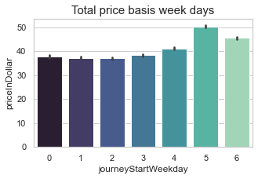
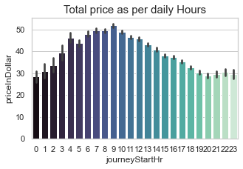
From Q1 to Q3, there is exponential increase in both no. of trips & the total price.
In Q4, although there is high number of trips, the overall price is lower that Q3 & Q2.
(Their might by offers from the company which lead to this high demand & low-price pattern.)
From charts, it seems that the overall revenue earned each day is directly proportional to the number of trips.
(There may be differences in price when looking w.r.t. features such as hr. of the day and trip duration, but the overall trend is maintained)
The trips v/s hour graph show clearly depicts that during night hours & early morning hours the trips are very less but the cost is too high.

